Slide 1
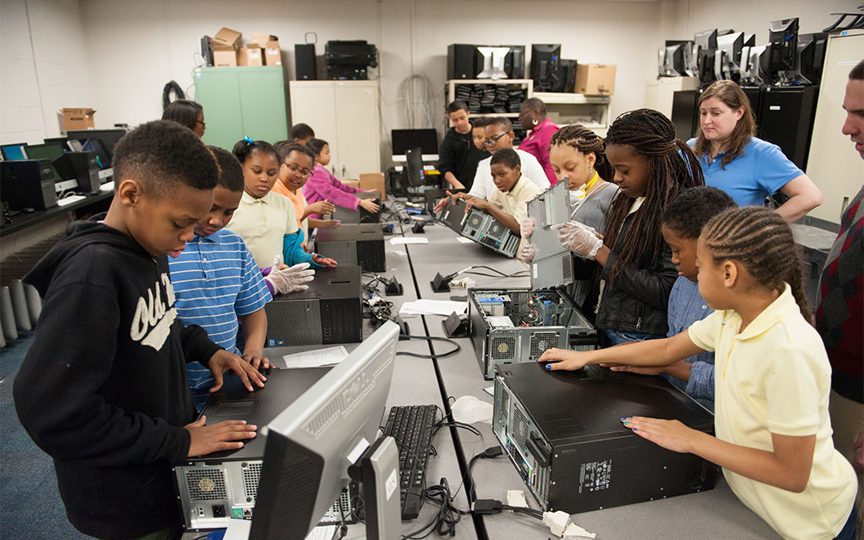

EduCycle database
Turhan Kimbrough
Andy Strombrewer
Alexander Dao

Slide 2
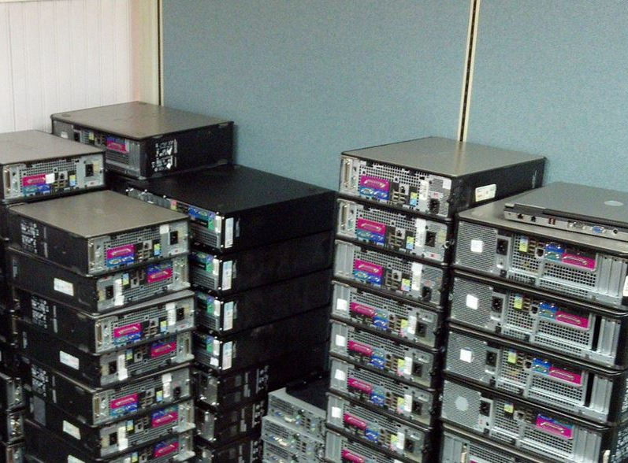
About the Company
Extend the lifespan of computers to continue to serve students’ interest
Provide service-learning opportunities for participants in the computer reconditioning aspect of the program
Complement and expand the TU's Green initiative
After campus needs are met, offer refurbished computers to local public schools where they will continue to contribute to student learning success
Notes:
These are the four main points of the company... the goals really
The last bullet point is where we jump in with this project/database...
our goal was to create a database to store all of the refurbirhsed computers that were given to the local public schools and combine it with the schools database

Slide 3

Objective
After campus needs are met, offer refurbished computers to local public schools where they will continue to contribute to student learning success
The creation of the database is to help improve the data storage of reconditioned computers
Keep information about reconditioning sessions
Track computer's location
Notes:
our goal was to create a database to store all of the refurbirhsed computers that were given to the local public schools and combine it with the schools database

Slide 4
Documentation
Use Cases
Schema
ERD

Slide 5
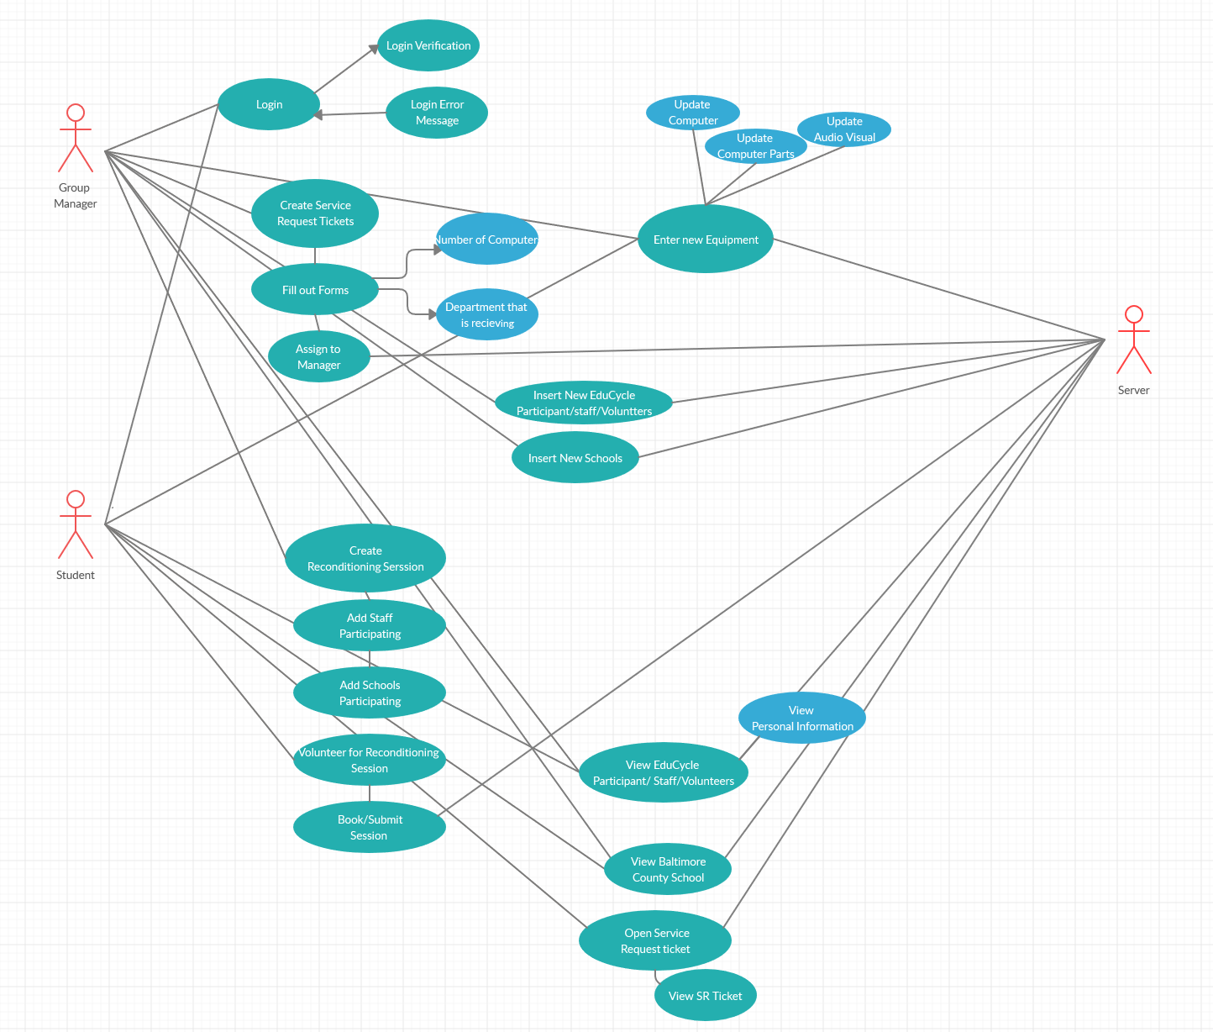

Use Cases
Actors:
-Group Manager
-Student
-Server
Notes:
Talk about the main things (5 main things our database does)
1) Log in
(Both Group Manager and Student)
2) Create Service Request Tickets
(Group Manager ONLY)
3) Entering new Equipment
(Both Group Manager and Student)
4) Create reconditioning Session
(Group Manager ONLY)
5) Viewing Tables
(Both Group Manager and Student)

Slide 6
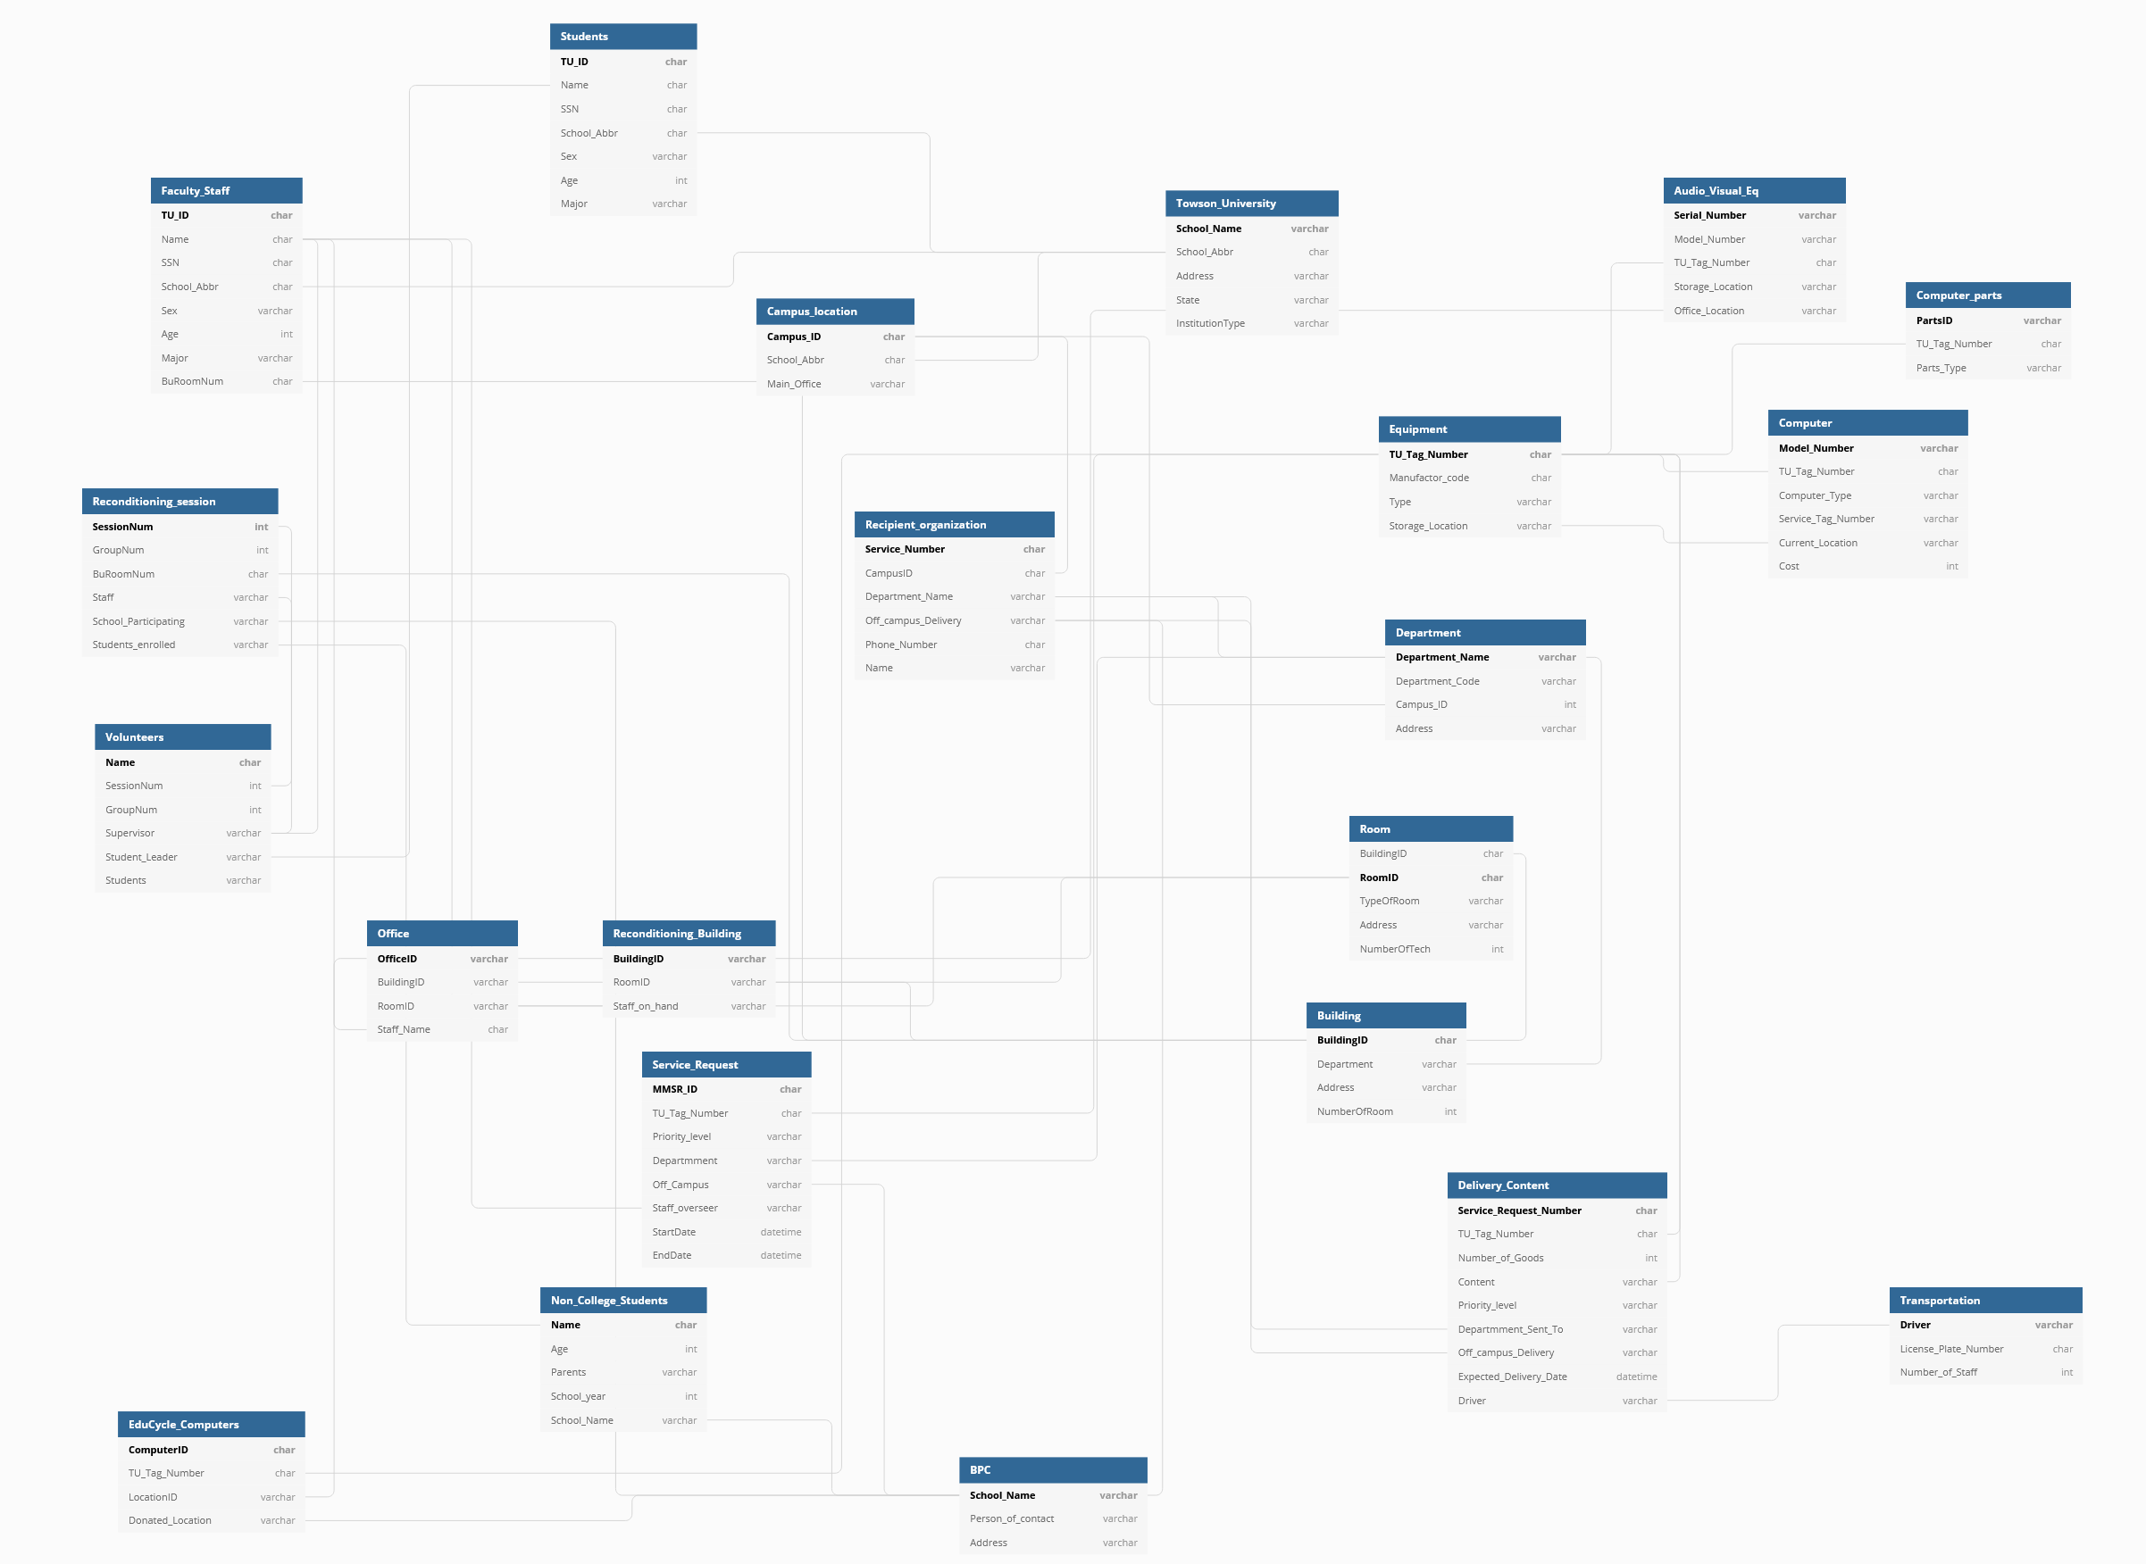
Notes:
(Can only show parts of the schema, it’s a bit large))
I guess we can talk about how we are making sure every table has a primary, and are connected to at least two tables.
Example:
Recondtioning session
Primary key- Session Number
Foreign Key- BuRoomNum
Foreign Key – Staff (Person in charge of the session... also is a primary in Faculity and staff)

Slide 7
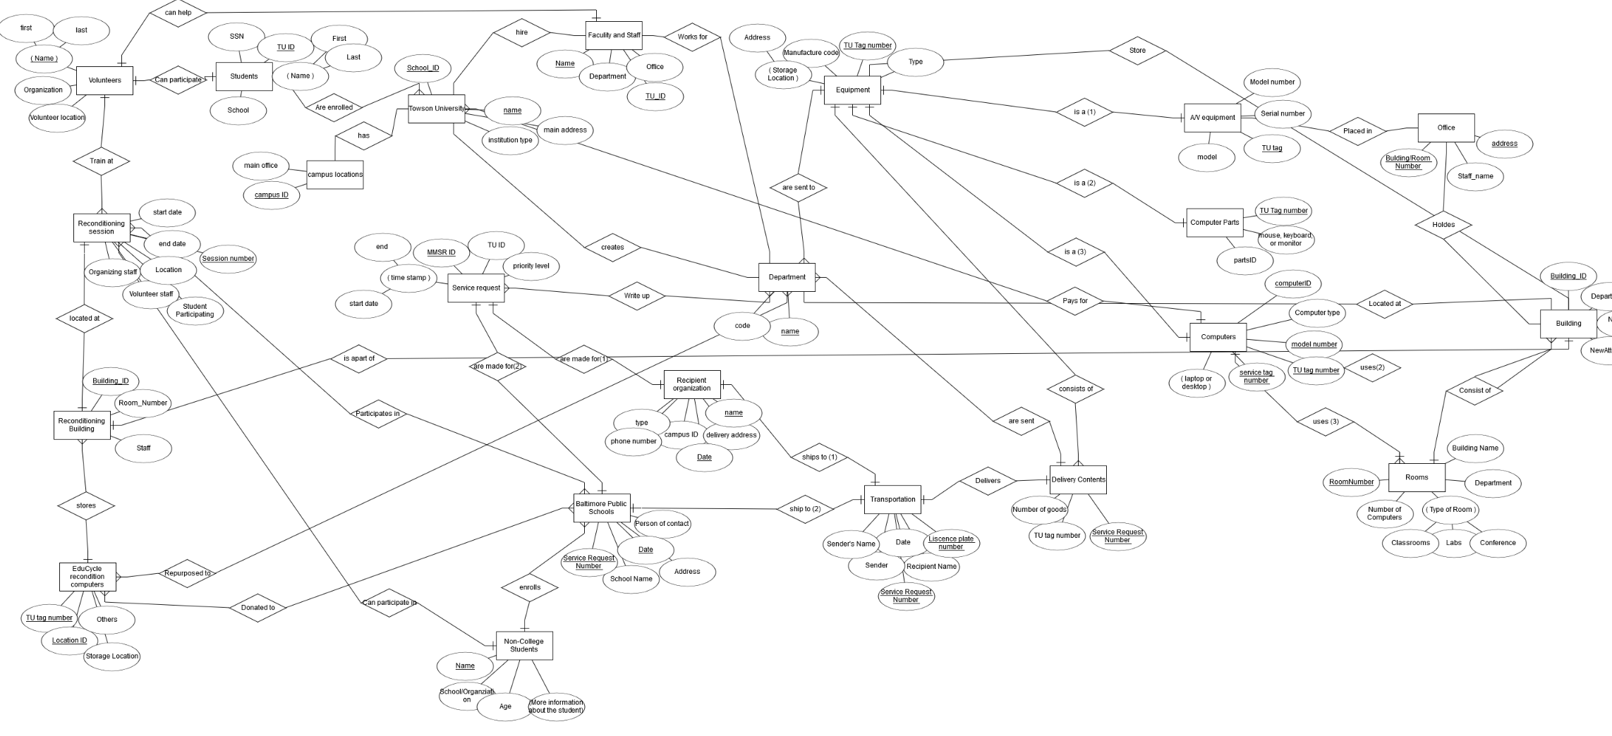
Notes:
No idea what you wannat talk about this.. Next slide is a little zoomed in on the ERD. Closer to the Reconditioning session side

Slide 8
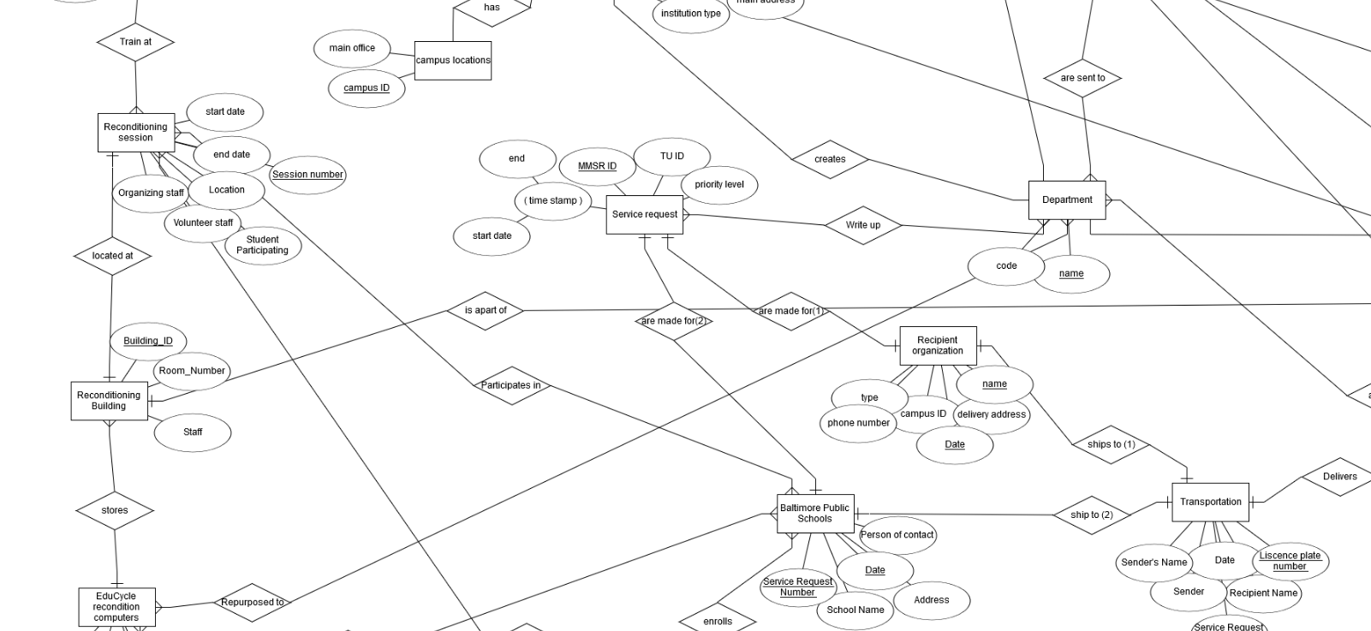
Notes:
No idea what you wannat talk about this.. THIS slide is a little zoomed in on the ERD. Closer to the Reconditioning session side

Slide 9

EduCycle Database/Application
Database
Application

Slide 10
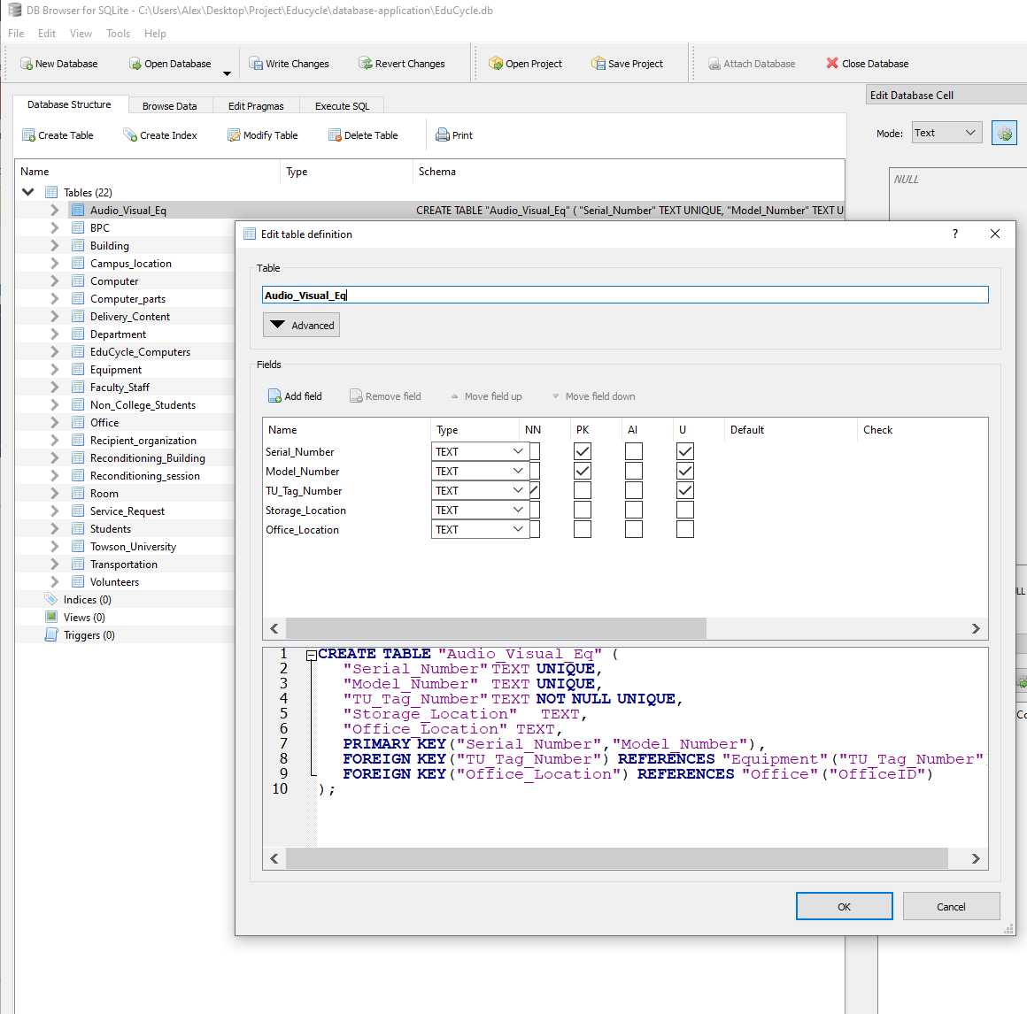
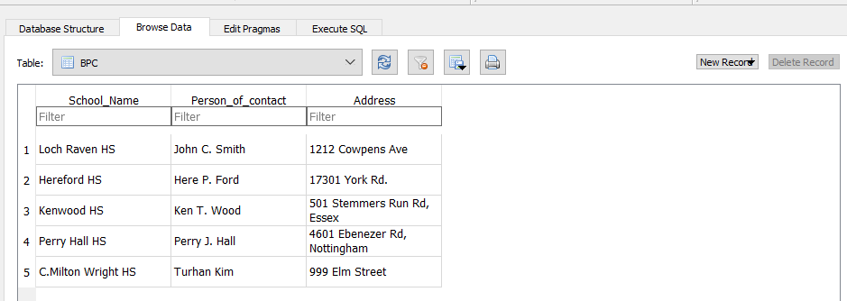
DB browser (Sqlite)
Creating Tables
Inserting Data
Notes:
Talked about:
Why we used DB Browser
Benefit of Creating tables (Don’t have to type that shit out)
Inserting the data
Importing it to our interface python thing

Slide 11
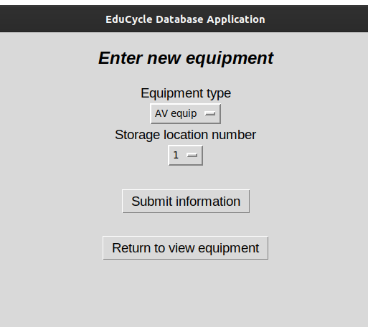
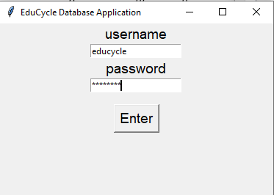
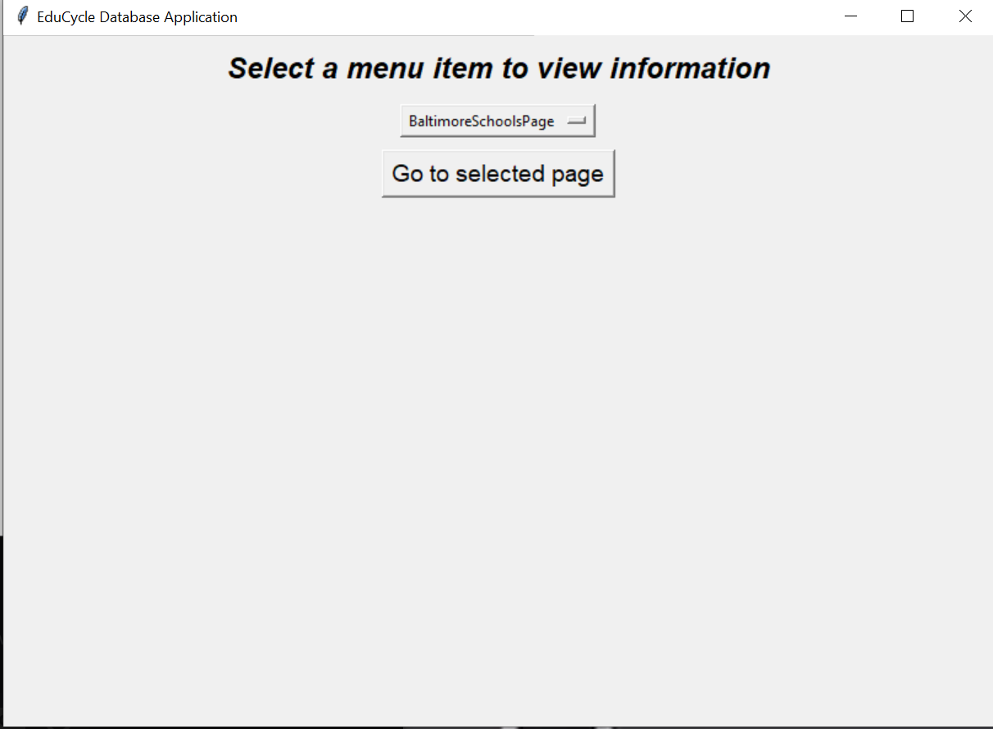
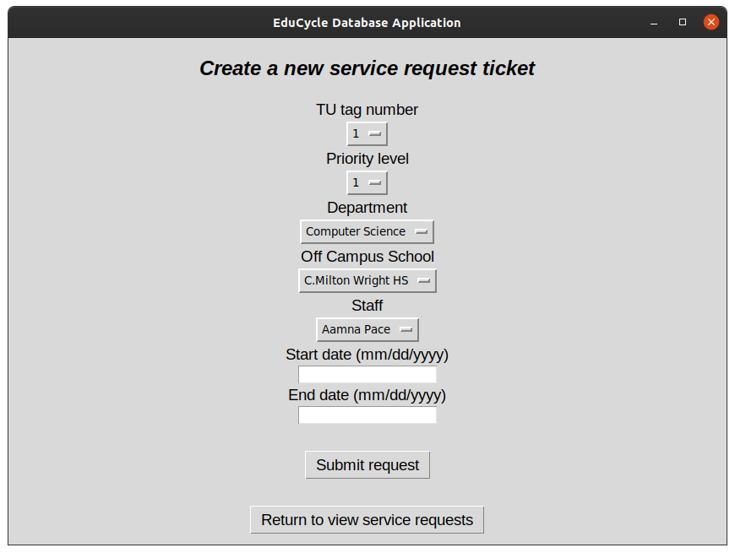
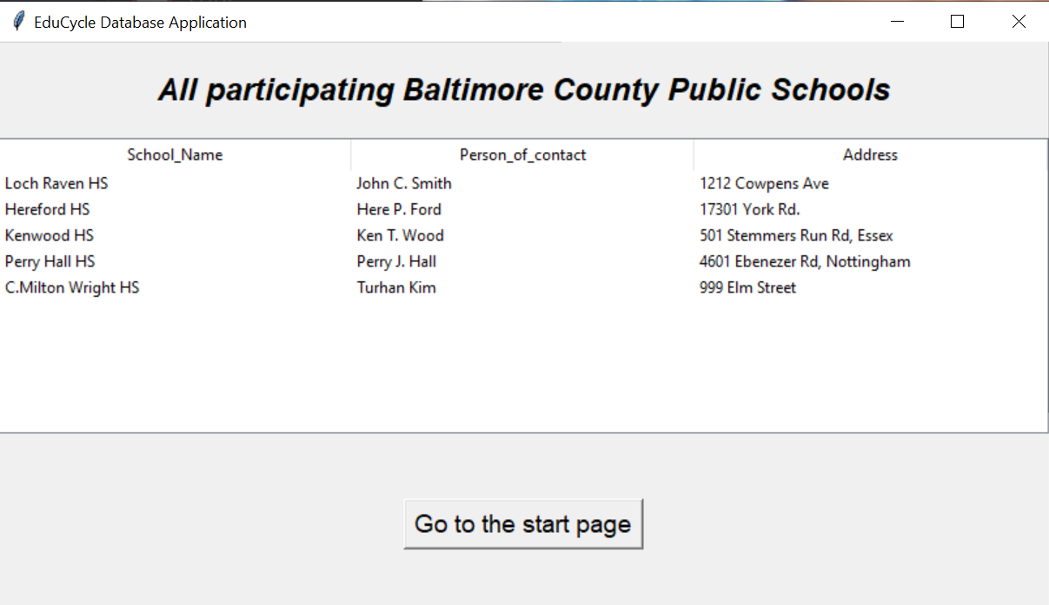
Database Application
(*) ONLY Group Manager can access
To/From
Notes:
A sample transition of our application
You can mention that the "All participating Baltimore County Public Schools" is the same as the database in DB Browser in the previous slide (This was to show that the database information transferred correctly)
You can also mention there is a log in for "students" and "admin" (lie about it)
Some functions can only be accessible to group manager, such as:
-Creating Service Request Tickets

Slide 12

Thank You
No questions

Slide 13
Work cited
https://sqlitebrowser.org/
http://educycleprogram.com/
https://erdplus.com/

